Slide 1


MINDSPARK’S
DYNAMIC QUESTIONING
Supervised by:
Dr. Syed Khaldoon Khurshid
G26-MindSpark

Slide 2


HOW MINDSPARK GENERATES QUESTIONS
User Prompt
Each symptom is mapped to a predefined question bank based on DSM-5 criteria. The AI then selects the most relevant questions to refine the diagnosis.
Symptom Extraction
Question Generation

Slide 3
PROMPTING
I've been feeling very low and tired all the time. I don't feel like doing anything anymore
Feeling low
Tired All time
Feel like don’t do anything

Slide 4
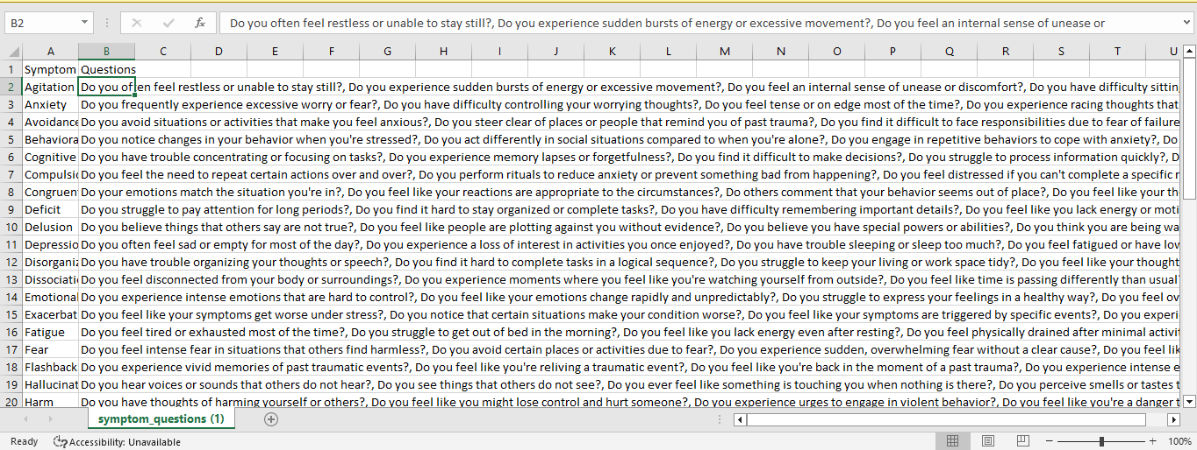
AI MATCHES SYMPTOMS
TO DIAGNOSTIC QUESTIONS

Slide 5
MATCHING SYMPTOMS
WITH OUR DATASET
Questions
Do you often feel sad or empty for most of the day?
Do you experience a loss of interest in activities you once enjoyed?,
Do you have trouble sleeping or sleep too much?,
Do you feel fatigued or have low energy nearly every day?,
Do you experience feelings of worthlessness or excessive guilt?
Do you have difficulty concentrating or making decisions?
Do you feel hopeless about the future?
Do you have recurring thoughts of death or suicide?
Feeling Low
Fatigue
Stress
Depressoin

